Slide 1
MVS (Multiple Virtual Storage)
Overview

Slide 2
Classification Of Computers
Questions

Slide 3
Classification of Computer
1. Micro Computer
2. Mini Computer
3. Mid-range Computer.
4. Mainframe Computer.

Slide 4
Introduction:
Categories of computer
Micro computer
eg: PC, Laptops
Mini computer and Work Station
eg: Unix, Nighthawk
Midrange computer
eg: AS/400
Mainframe computer
eg: system/360,370,390 and Z/OS
Super computer
eg: Cray 1, 2, X-MP, ETA-10.

Slide 5
Why Companies choose various Computers?
Based on the requirements of the application and clients.

Slide 6
What is an Operating System
Question

Slide 7
What is an Operating system?
Operating system is a system software which acts as a an interface between the hardware and the application software.
Application
OS
HW

Slide 8
What are the Different types of operating System ?.
Question

Slide 9
Types of Operating Systems.
Windows operating System
Unix operating System
OS/400 operating system.
MVS operating system.

Slide 10
What is an Application ?.
Question

Slide 11
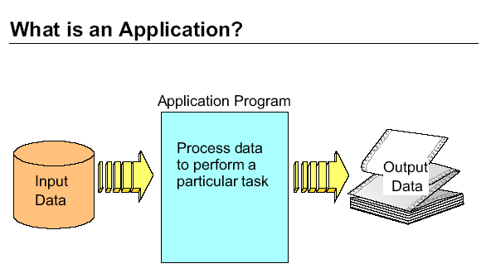
APPLICATION

Slide 12
Why we need to built Application Software?
Question

Slide 13
Why we need to built Application Software?
To meet Customer needs
Example: Billing Software
To meet the business requirements
Example : Purchase Software

Slide 14
Classification of Application Software
On-line Application.
Example. Air line and rail-way reservation Systems.
Batch Application.
Example. Generation of Monthly Salary Reports.

Slide 15
FEATURES OF OPERATING SYSTEM

Slide 16
Features Of Operating System
Multi-Tasking
Time Sharing
Multi-threading
Concurrency
Multiprocessor
Stability
Reliability
Security
Robustness

Slide 17
Multitasking
Multitasking means that the operating system (os) allows more than one task to be executed concurrently, regardless the task-use the same program or different programs.
Train Status
Program
J1
CPU
User 1
OS
Train Route
INQUIRY
User 2
J2
Memory
TICKET SALES
Program
User 3
J3
Disk

Slide 18
Time Sharing
Resource Sharing
Multiple Users compete for computer resources at the same time
At any given point in time only one user can have control of the resources

Slide 19
Multithreading
Multithreading is the system environment where the tasks are sharing the same program under the multitasking environment.
It is the subset of Multitasking.
Ticket Cancel
RESERVAT
Program
CPU
User 1
J1
OS
Ticket
Reservation
J2
User 2
Ticket
Reservation
J3
Memory
User 3
Ticket
Sales
User 4
j4
Disk

Slide 20
Multiprocessor
CPU 1
Train Status
Program
J1
CPU 2
User 1
OS
CPU 3
Train Route
INQUIRY
User 2
J2
Memory
TICKET SALES
Program
User 3
J3
Disk

Slide 21
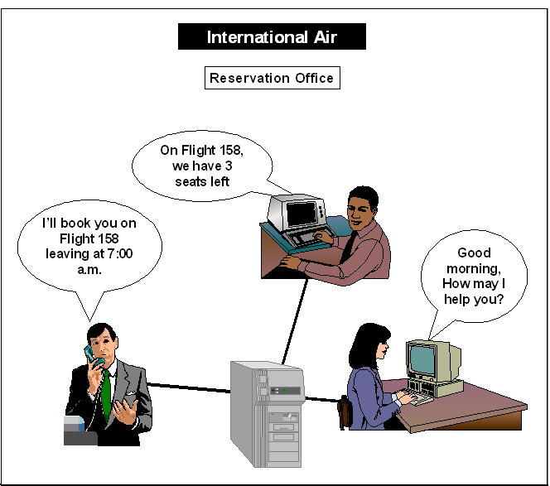
Concurrent Access
Online Reservation System

Slide 22
Security
Datas processing in OS should be secured so that other person should not access it in any ways.
Server Level
Group Level
User Level
Object Level
Data Level

Slide 23
Transaction Processing
A Transaction is a logical unit of work.
A Transaction can have one or more number of Tasks.
Example The withdrawal of money and mini-statement in ATM.

Slide 24
Robustness
The system is called as Robustness when it can supporting (executing) huge number of tasks concurrently.
Mainframe computer is highly Robustness when compared to other computers.

Slide 25
What is the Role Of operating System
Question

Slide 26
Role of an Operating System
Manage hardware resources in the computing system:
Processor
Memory
Input/Output
Printers
Information
Provide services to application programs and end-users through well defined interfaces

Slide 27
Processor Management
Job which is currently executing in CPU is called RUN STATE
Job which ran for some time in CPU and it been “INTRUPTTED by I/O “ , its called WAIT STATE
Job which is ready for Execution for First Time is called READY STATE
Ready
State
J1
CPU
(Run State)
Disk
CPU issue
J1 I/O REQ
Ready
State
J2
J1 -> WAIT STATE
Ready
State
J3

Slide 28
Memory Management
The problem:
All code and data for a given task must be in memory for a task to be executable
Options:
Place tasks in 'real' memory
Place tasks in 'virtual' memory

Slide 29
Real memory implementations:
Code and data are in real memory
Size of code and data limited by size of installed memory
Good performance, low overhead
Possible wastage of memory

Slide 30
Virtual storage
Is a technique that lets a large amount of main storage be simulated by a processor that actually has a smaller amount of main, or real storage.
Processor creates virtual storage by using disk storage to simulate and extend real storage.
Current program instruction being executed and any data it requires have to be in real storage.
Other data and instructions can be placed in virtual storage.
And recalled into real storage when needed.

Slide 31
Virtual Memory
When a Program requires to transfer and process huge data ( 1GB)
Main Memory : 128 mb
Virtual Memory : 2 or 3 Times of Real Memory
J1
OS
CPU
Disk
(Auxillary Memory)
Virtual Memory
J2
Main
Memory
J3

Slide 32
How a user Communication with Other System ?.
Question

Slide 33
How Application Interacts with Device ( Hard disk, Keyboard,Monitor) ?.
Question

Slide 34
How the data gets transferred from Main memory to Hard disk ?.
Question

Slide 35
Input-Output Management
The I/O subsystem:
Consists of I/O processors, device controllers and devices
Receives an I/O request in a standard format
Handles all interactions with the actual devices
Moves data between memory and the device and vice-versa
Notifies the processor at the end of the operation
While the I/O subsystem is processing the request, the processor is free to execute other work

Slide 36
Spooling
CPU 1
Train Status
REPORT
User 1
J1
OS
Printer
TRAVEL
PASSENGER
CHART REP
User 2
J2
TICKET SALES
REPORT
J3
User 3
Disk
(Stores the job Output In Spool
Area(QUEUE)

Slide 37
Spooling
'Spooling' (Simultaneous Peripheral Operation On Line)
All output to spooled devices is first written to disk
The spool manager then provides facilities like:
Release output to actual printers
Selective delete processing
Error handling
Recovery and restart

Slide 38
Information Management
The problem:
The application is interested in information, not data
Organising and presenting data in a useful form
Solutions:
Files and File systems
Access methods or device drivers
System Managed Storage

Slide 39
Interface to Users and Applications
User interface is of several kinds:
Online user interface
Batch user interface
Application programming interface

Slide 40
General Operating Compared to Multiple Virtual Storage (MVS) Operating System

Slide 41
Comparison
Let's apply the same concepts to MVS...
Processor Management: Jobs and Jobsteps
Memory Management: Address Spaces
I/O Management: Channel Subsystem
Spooling: Job Entry Subsystem
Information Management: Storage Management Subsystem
User interface: TSO, JES2, system utilities and macros

Slide 42
The evolution of OS

Slide 43
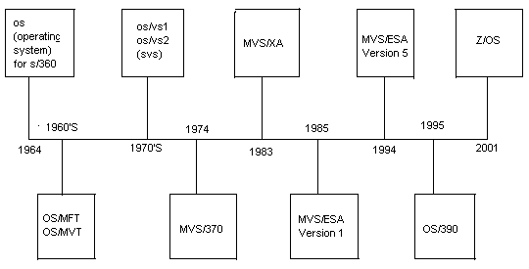

Slide 44
Job and Jobsteps
Processor Management

Slide 45
Job and Jobsteps
Jobs and Jobsteps
"JOB" in MVS is a generic term for any work to be performed
A Job could be:
An online user
A system task
A subsystem
A 'real' batch job
A Jobstep is the execution of a single program within a job
A job consists of one or more jobsteps

Slide 46
Job and Jobsteps
Examples of jobsteps:
Reservation program for an BATCH user
System task such as Controlling User /Resources
A user program or system utility
The Job Entry Subsystem manages all jobs and jobsteps

Slide 47
Address Space
Memory Management

Slide 48
Address space
An address space is the amount of storage seen by a job
MB in MVS/SP and older systems
GB in MVS/XA and MVS/ESA
Each job executes in an address space
Online users each have a Time Sharing User (TSU) address space
Batch jobs execute in an Initiator address space
An address space is organized as a set of:
Segments (1MB each)
Pages (256 pages per segment, each page is 4K)

Slide 49
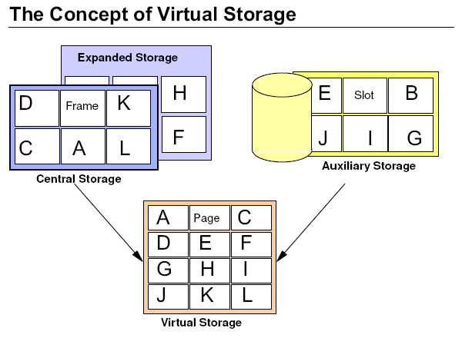

Slide 50
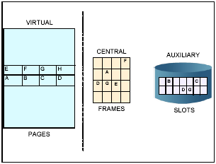
Address space
Main Memory is divided as Frames
Virtual Memory is divided as PAGES
Auxiliary Memory is divided as SLOTS

Slide 51
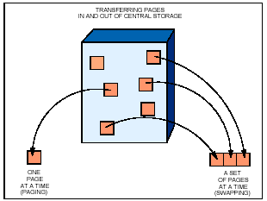
Address Space

Slide 52
Paging
When a program is selected, the system brings it into virtual storage and divides it into pages of 4K bytes. The system transfers the pages of a program into central (real) storage for execution and out to auxiliary storage when not needed.

Slide 53
Swapping
Swapping is transferring a set of pages in and out of main storage at a time.
Swapping is similar to paging, but it occurs at a higher level.
Paging is transferring one page at a time while swapping is transferring one or more pages at a time.

Slide 54
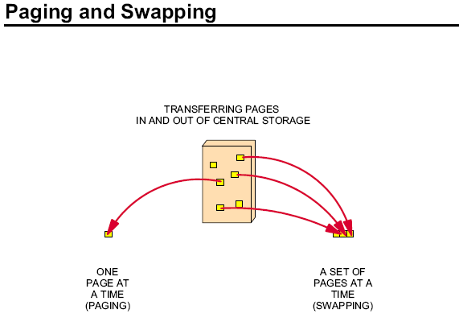

Slide 55
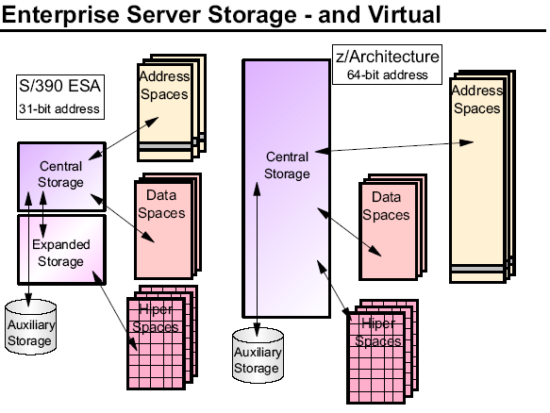

Slide 56
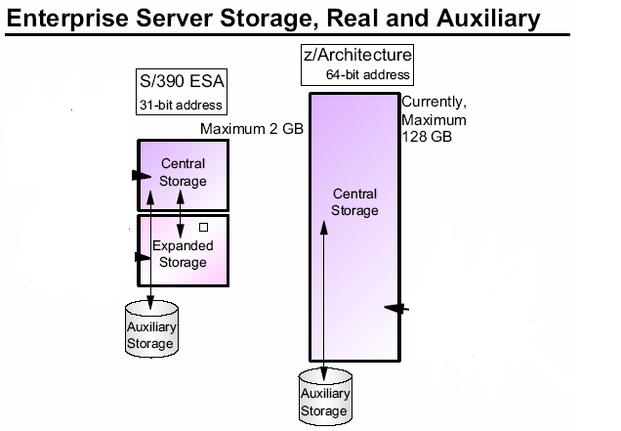

Slide 57
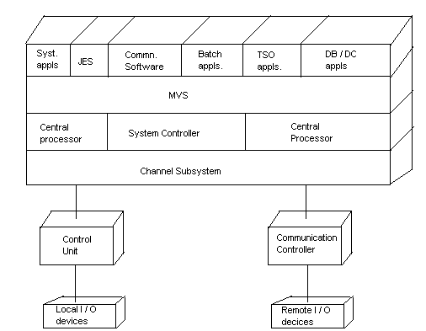
Hardware Overview

Slide 58
System Controller
Monitors communications
Controls Data flow
Error Checking / Reporting

Slide 59
Central Processor
Executes CP program Instructions
Issues I / O Instructions

Slide 60
Central Storage
Type of processor storage where program instructions must reside while they are executing.
This type of storage was sometimes called “Real Storage”
Byte Addressable
System and User program
Data

Slide 61
Channel Subsystem
Handles CP I / O Request
Manages path selection
Controls data transfer
Assign I/O operation priority

Slide 62
Control Unit
Control I/O devices
Sends device status to channel sub system

Slide 63
SPOOLING
JOB ENTRY SUBSYSTEM(JES)

Slide 64
Spooling
Managed by the Job Entry Subsystem (JES)
All outputs intended for printing are first stored in special, 'spool' DASD
Can be viewed and manipulated from an online session using the System Display and Search Facility (SDSF)
Outputs are normally in the 'Held' queue, unless released to the 'Output' queue
JES also uses the spool for managing batch queues

Slide 65
Data Management

Slide 66
Data Set
A Data set is defined as a collection of data which resides in the storage device, accessed and used by the input/output system.
Data sets can reside on DASD, Magnetic tapes or Magnetic cartridges.
MAINFRAME
DASD
MAGNETIC
CATRIDGES
MAGNETIC
TAPES

Slide 67
Data Set Organizations
There are two types of data set organizations.
VSAM Data Sets
Non-VSAM Data Sets.

Slide 68
JOB MANAGEMENT

Slide 69
JOB
A Job is a set of user tasks to be completed by the system.
Every Job is identified by a Job-id, which is eight characters long.
Each individual task is called a job step.
A job step typically executes a Program using input data sets and writes output data sets.

Slide 70
Job Processing
Job Entry Subsystem (JES) is responsible for managing jobs in an MVS system.
In order to support a user workload, MVS requires assistance.
The JES processes job in the order of its priority, which is coded on the JOB statement using the ‘prty’ parameter.

Slide 71
System Defined Datasets
There are various System defined data sets available. They are:
Sys1.nucleus
Sys1.parmlib
Sys1.linklib
Sys1.logrec
Sys1.proclib

Slide 72
